Slide 1

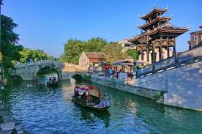
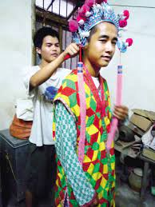

Some synchronic and diachronic views on the Cantonese lexical suprafixes
https://t.ly/QhD_
Hilário de Sousa
Centre de recherches linguistiques sur l’Asie oriental / CRLAO –
École des hautes études en sciences sociales / EHESS
hilario@bambooradical.com
Chinese dialect grammar in typological perspective
Venerdì 28 aprile 2023 癸卯年三月初九
Università Ca’ Foscari
Notes:
Hello everyone. I’m Hilário de Sousa. Today I am going to talk about some issues related to the lexical suprafixes in Cantonese.

Slide 2
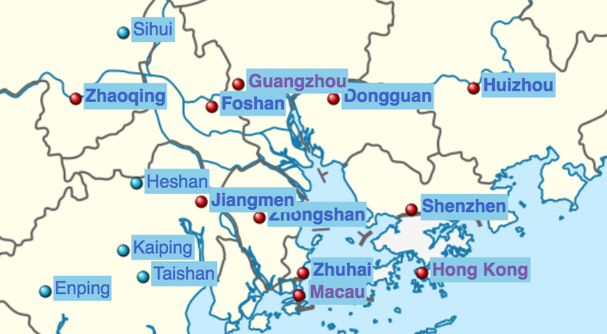
“Cantonese”
https://t.ly/QhD_
Narrowly defined:
Language of 廣州 Canton / Kwongchow / Guangzhou
and the Cantonese enclaves elsewhere (de Sousa 2021)
← Nanning
Notes:
First of all. I use the term Cantonese quite narrowly. Cantonese is the language of Canton Guangzhou. Standard Cantonese is Standard Yue Chinese. The Yue dialect of nearby Foshan is marginally Cantonese, but the Yue dialects slightly further like Zhaoqing, Zhongshan, Dongguan are already not Cantonese, in my definition Like the tones are obviously different. However, in the last 180 years or so, after the first opium war, there has been a massive amount of emigration from the Canton area, and hence you find many pockets of Cantonese speakers elsewhere. Within the region, many Cantonese speakers migrated along the coast, or along the rivers, and you find many Cantonese enclaves. The most important Cantonese enclave is Hong Kong. Two other examples are Macau, and city centre of Nanning, Nanning to the west, the capital of Guangxi Zhuang Autonomous Region. These various Cantonese varieties are slightly different from each other, because of their different language contact environments. But they are obviously Cantonese, their tones are basically the same.

Slide 3
https://t.ly/QhD_
modern Standard Cantonese
Six tonemes: 1 [˥] 2 [˧˥] 3 [˧]
4 [˨˩] 5 [˩˧] 6 [˨]
詩 /si1/ [˥] ‘poem’ 史 /si2/ [˧˥] ‘history’ 試 /si3/ [˧] ‘try’
時 /si4/ [˨˩] ‘time’ 市 /si5/ [˩˧] ‘city’ 事 /si6/ [˨] ‘matter’
唧 /tsit1/ [˥] ‘tickle’ 節 /tsit3/ [˧] ‘festival’ 截 /tsit6/ [˨] ‘sever’
(tsit7) (tsit8) (tsit9)
 | *A | *B |  | *C | *D, L | *D, S
*vceless | 1 ˥ (~˥˧) | 2 ˧˥ |  | 3 ˧ | 3(8) ˧ | 1(7) ˥
*voiced | 4 ˨˩ | 5 ˩˧ | 6 ˨ |  | 6(9) ˨
Notes:
Modern Standard Cantonese has six tonemes: si1 si2 si3 si4 si5 si6. Tones 1 2 3 4 5 6. As for the obstruent-ending syllables, usually, they have tones 1 3 6, tsit7 tsit8 tsit9. Sometimes these are numbered seperately 7 8 9. In this talk we will follow this.

Slide 4
https://t.ly/QhD_
Non-lexical suprafix
Lexical suprafix
Not determined by the lexical identity of the host
e.g. high rising ˧˥ prv < tsɔ ˧˥ prv
sɛk ˧˥ kʰɵy˩˧
sɛk˧ tsɔ˧˥ kʰɵy˩˧ 錫咗佢
kiss prv 3sg
‘(X) kissed s/he/it’
jɐu˧˥ pʊŋ˨ tsʰœŋ˨˩
jɐu˨˩ tsɔ˧˥ pʊŋ˨ tsʰœŋ˨˩ 油咗埲牆
paint prv clf wall
‘(X) painted the wall’
Determined lexically
e.g. high rising ˧˥ on (typically) nouns
橙 tsʰaŋ˨˩ > ˧˥ ‘orange’
梨 lei˨˩ > ˧˥ ‘pear’
李 lei˩˧ > ˧˥ ‘plum’
碌柚 lʊk˥ jɐu˨ >˧˥ ‘pomelo’
but
杏 hɐŋ ˨ ‘apricot’
龍眼 lʊŋ˨˩ ŋan˩˧ ‘longan’
菠蘿 pɔ˥ lɔ˨˩ ‘pineapple’
榴槤 lɐu˨˩ lin˨˩ ‘durian’
Notes:
Next, in this talk we are talking about lexical suprafixes. So there are non-lexical and lexical suprafix. Non-lexical suprafixes are not determined by the lexical identity of the host. For example, there is the high rising suprafix meaning perfective, and it comes from the perfective marker zo2. sek2 keoi5 comes from sek3 zo2 keoi5, jau2 bung6 coeng4, comes from jau4 zo2 bung6 coeng4. Given that this high rising suprafix is a perfective marker, the host is going to be a verb or an adjective, and there are some phonological constraints, but whether you can use this perfective suprafix or not is not determined lexically. On the other hand, the lexical high rising suprafix that is typically used on nouns is lexically determined. For example, it is applied to caang2 ‘orange’, lei2 ‘pear’, lei2 ‘plum’, and luk1 jau2 ‘pomelo’, but it is not applied to hang6 ‘apricot’, lung4 ngaan5 ‘longan’, bo1 lo4 ‘pineapple’, and lau4 lin 4 ‘durian’. It is just lexically determined. As for the lexical suprafixes, I am not calling these nominal suprafixes because they can be applied to other word classes as well, including verbs, very rarely. I am also not calling these diminutives, because in Cantonese, nowadays these usually do not have any diminutive-type meanings at all. (Although historically there were most probably diminutives.

Slide 5
Non-lexical suprafixes
Not determined by the lexical identity of the host
sɛk -˧˥ kʰɵy˩˧
錫 咗 佢
sɛk˧ tsɔ˧˥ kʰɵy˩˧
kiss prv 3sg
‘(X) kissed s/he/it’
jɐu -˧˥ pʊŋ˨ tsʰœŋ˨˩
油 咗 埲 牆
jɐu˨˩ tsɔ˧˥ pʊŋ˨ tsʰœŋ˨˩
paint prv clf wall
‘(X) painted the wall’
Notes:
Next, there are two types of suprafixes: lexical and non-lexical suprafixes. With non-lexical suprafixes, we are talking about tonal affixes which are synchronically clearly the remnant of a morpheme which has its segments elided, and whether the suprafix can apply or not is not dependent on the host, not dependent on the leixcal identity of the host. For instance, sek2 keoi5 is sek3 zo2 keoi5, jau2 pung6 coeng4 is jau2 zo2 pung6 coeng4. The segments of the perfective marker zo2 has been elided. Given that zo2 is a perfective marker, the host is going to be a verb or adjective, whether you can use the high rising suprafix a2 or not is not determined lexically.

Slide 6
Non-lexical suprafixes
Not determined by the lexical identity of the host
sɛk˧˥ tam˨ sin˥
jɐn˧˥ sɐi˧ mɐt˧˥ sɐi˧
人 一 世
jɐn˨˩ jɐt˥ sɐi˧
person one clf.life
物 一 世
mɐt˨ jɐt˥ sɐi˧
object one clf.life
idiom: Life is very short
錫 一 啖 先
sɛk˧ jɐt˥ tam˨ sin˥
kiss one clf first
‘(Let X) give (Y) one kiss first’
Notes:
Next, there are two types of suprafixes: lexical and non-lexical suprafixes. With non-lexical suprafixes, we are talking about tonal affixes which are synchronically clearly the remnant of a morpheme which has its segments elided, and whether the suprafix can apply or not is not dependent on the host, not dependent on the leixcal identity of the host. For instance, sek2 tam6 sin1 is sek3 jat1 dam6 sin1, with the segments of the numeral jat1 elided. Similarly, jan2 sai3 mat2 sai3, and idiom meaning ‘life is very short’, the tone of the numeral jat1 has been in a sense combined with that of the preceding syllable. Suprafixes like these are not determined by the lexical identity of the host. whether you can use the high rising suprafix a2 or not is not determined lexically.

Slide 7
Lexical suprafix: tone 2 [˧˥ ]
https://t.ly/QhD_
high rising suprafix [ ˧˥ ]: very common
e.g. 妹 mui 6 [ ˨ ] > 2 [˧˥ ] ‘younger sister’ (independent word)
我 個 妹
ŋɔ 5 kɔ 3 mui 6 > 2
1sg clf y.sis
‘my younger sister’
姊 妹
tsi 2 mui 6 > 2
o.sis y.sis
‘sisters’
Notes:
The most commonly found suprafix is tone 2, high rising.
For example, mui6, plus a high rising suprafix, becomes mui2, which is an independent word meaning ‘younger sister’, for instance, ngo5 go3 mui2 ‘my younger sister’. The high rising suprafix is also applied, unpredicatbly, to some other words, for example tsi2 mui2 ‘sisters.

Slide 8
Lexical suprafix: tone 1 [ ˥ ]
https://t.ly/QhD_
high level suprafix [ ˥ ]: rarer
e.g. -妹 -mui 6 [ ˨ ] > 1 [ ˥ ] ‘girl’ (suffix)
坡妹 聾妹
pɔ 1 -mui 6 > 1 lʊŋ 4 -mui 6 > 1
pore-girl deaf-girl
‘Singaporean girl’ ‘deaf girl’
妹仔 mui 6 > 1 -tsɐi 2
girl-dim
‘female servant’
Notes:
Another lexical suprafix is tone 1, high level, which is less commonly found. For example, mui6 plus a high level suprafix becomes mui1, which is a suffix, meaning ‘girl’, for instance bo1 mui1, is a singaporean girl, lung4 mui1 is a deaf girl. The high level suprafix is also applied to some other words, unpredicatbly, for example mui1 zai2, a ‘female servant’.

Slide 9
https://t.ly/QhD_
In citation tone:
bound root 妹 mui 6 [ ˨ ] ‘younger sister’ (< Mid. Chi. 妹 mwoj^{C})
妹 夫
mui 6 fu 1
y.sis husband
‘younger sister’s husband’
兄 弟 姊 妹
hɪŋ 1 tɐi 6 tsi 2 mui 6
o.bro y.bro o.sis y.sis
‘siblings’
Notes:
These contrast with mui6, in citation tone, which is a bound root. Mui6 is used in words like mui6 fu1 ‘younger sister’s husband’, hing1 dai6 zi2 mui6 ‘siblings’.

Slide 10
Lexical suprafix: tone 2 [˧˥ ]
https://t.ly/QhD_
any tone other than tone 1/7 [˥] can take suprafix tone 2:
片 pʰin 3 ‘slice’ > pʰin 2 e.g. ‘film’, ‘slide’
房 fɔŋ 4 ‘room’ > fɔŋ 2 ‘room’
女 nɵy 5 ‘female’ > nɵy 2 ‘daughter’
袋 tɔi 6 ‘bag’ > tɔi 2 ‘bag’
鴨 ap 8 ‘duck’ > ap 2 ‘duck’
碟 tip 9 ‘plate’ > tip 2 ‘plate / disc’
Notes:
The high rising suprafix can be applied to a host in any non-high tone. So for instance

Slide 11
Lexical suprafix: tone 1 [ ˥ ]
https://t.ly/QhD_
any(?) non-/1/ tone can become /1/(7):
己 kei 2 ‘self’ >自己 tsi 6 kei 2 ~ 1 ‘self’
派 pʰai 3 ‘faction’ > pʰai 1 ‘faction’
欄 lan 4 ‘railing’ > lan 1 ‘(animal) pen’
尾 mei 5 ‘tail’ > mei 1 ‘last’
妹 mui 6 ‘y. sister’ > -mui 1 ‘girl’
(8 > 1?)
掠 lœk 9 ‘rob’ > lœk 7 ‘rob’
(e.g. 掠水 lœk 7 sɵy 2
rob money)
Notes:
The high level suprafix can be applied to a host in seamingly any tone other than itself. So for instance, ‘self’ is zi6 gei2 or zi6 gei1

Slide 12
https://t.ly/QhD_
suprafix tone 4 low falling [˨˩]: very limited
Some kin-like terms:
小妹妹 妹妹仔
siu 2 mui 6 > 4 mui 6 > 2 mui 6 > 4 mui 6 > 1 -tsɐi 2
small y.sis y.sis y.sis y.sis-dim
‘little girl’ ‘(naïve) young lady’
(Kin-like nicknames of 80s/90s HK celebrities:)
梅姐 達哥 哥哥
mui 4 > 1 -tsɛ 2 > 4 tat 6 -kɔ 1 > 4 kɔ 1 > 4 kɔ 1
Mui -o.sis Tat -o.bro o.bro o.bro
‘Anita Mui’ ‘Ng Man Tat’ ‘Leslie Cheung’
Some place names:
南灣 銅鑼灣
nam 4 wan 1 > 4 tʰʊŋ 4 lɔ 4 wan 1 (> 4)
south bay bronze gong bay
‘Praia Grande’ (Macau) ‘Causeway Bay’ (Hong Kong)
Notes:
There is actually another suprafix, tone 4, low falling. But this is very rare in Cantonese, and I will skip this.

Slide 13
Differences amongst Cantonese varieties
https://t.ly/QhD_
City centre became Cantonese dominant in:
late 19th century: Hong Kong (Ball 1888)
1940s: Macau (Zhān Bóhuì 詹伯慧 et al. 2002: 201–202)
1940s: Nánníng (Lì Mínghuì 利明慧 2008)
 | Nánníng Canto. | Older Macau Canto. | Hong Kong Canto.
繩 ‘string’ | ʃeŋ˨˩ | sɪŋ˨˩ | sɪŋ˧˥
帽 ‘hat’ | mu˨ | mou˨ | mou˧˥
鉗 ‘pliers’ | kʰɛm˨˩ | kʰim˨˩ | kʰim˧˥
碟 ‘plate’ | tip˨ | tip˨ | tip˧˥
枱 ‘table’ | tʰɔi˨˩ | tʰɔi˨˩ (>˧˥) | tʰɔi˧˥
枱布 ‘table cloth’ | tʰɔi˨˩ pu˧ | tʰɔi˨˩ pou˧ | tʰɔi˧˥ pou˧
澳門 ‘Macau’ | u˧ mun˨˩ | ou˧ mun˨˩ (>˧˥) | ou˧ mun˧˥
乞兒 ‘beggar’ | hɐt˥ -ji˥ | hɐt˥ -ji˥乞兒 hɐt˥ -ji˨˩ -tsɐi˧˥ 乞兒仔 | hɐt˥ -ji˥
Notes:
Hong Kong and Canton are at the forefront of the development of suprafixes. Looking at some other Cantonese varieties, for instance the Cantonese of Macau and Nanning, the city centre of these places became dominant in Cantonese later than Hong Kong, and correspondingly there are fewer words with suprafixes. The following are some examples. The middle column, by “Older macau Cantonese”, I am talking about how my parents pronounce these words. For instance, The second to last item, in Hong Kong, the word Macau is ou3 mun2, with a high rising suprafix at the end. In Macau, we also say ou3 mun2, but ou3 mun4, in citation tone, is also used quite often. The last item, a beggar, is very commonly hat1 ji1 in Cantonese varieties, but my mother would say hat1 ji4 zai2, with ji4 in citation tone.

Slide 14
Differences amongst Cantonese varieties
https://t.ly/QhD_
Wong Yee 黄翊 (2007: 90–91)
人们戏称，说 [ɔu³³ mun¹¹ jan¹¹] 者是真正的澳门人，说 [ɔu³³ mun³⁵ jan¹¹] 者是假冒 的澳门人。不过这种差别正在缩小。
[In Macau Cantonese, in contast to Hong Kong Cantonese:]
People joke that, one who says [ou˧ mun˨˩ jɐn˨˩] is a real Macau person, one who says [ou˧ mun˧˥ jɐn˨˩] is a fake Macau person. But this type of difference [the usage of suprafixes] is narrowing.
Lín Yì 林亦 & Qín Fèngyú 覃凤余 (2008: 90)
使用远无广州、香港白话那么普遍，基本可以穷尽。
[In Nanning Cantonese, the high rising suprafix:]
The usage is far less common than Canton and Hong Kong Cantonese, [examples] can bascially be exhaustively listed.
Chén Xiǎojǐn 陈晓锦 & Chén Tāo 陈滔 (2005: 26)
例子很少，在我们的词汇表里，我们一共记录了七个有变调的词。
[In Beihai Cantonese, the high level and high rising suprafixes:]
There are very few examples, in our vocaulary list [2179 items], there are in total seven items with a suprafix.
Notes:
Some quotes

Slide 15
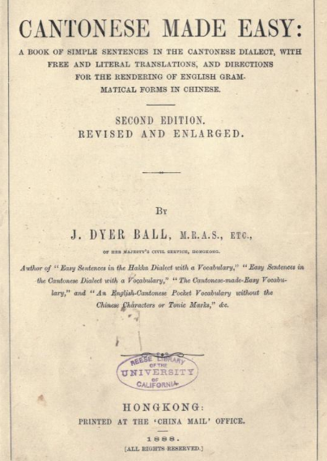
Ball (1888)
https://archive.org/details/cantonesemadeeas00ballrich
Phrasebook/textbook plus grammar scatch
Published in HK Scenes depicted in the textbook section clearly HK
“pure Cantonese”; Sai Kwán wá [西關話 of Canton] as standard (:xv)
Notes:
Now what about the historical situation? I had a look at Ball (1888) Cantonese Made Easy. This is a phrasebook / textbook, plus a grammar scatch. It was published in Hong Kong, and the scenes depicted were clearly from Hong Kong. It says that it depicts the pronunciation of ‘pure Cantonese’, meaning the pronunciation of sai1 gwaan1 area of Canton.

Slide 16
https://t.ly/QhD_
modern Standard Cantonese
 | *A | *B |  | *C | *D, L | *D, S
*vceless | 1 ˥ (~˥˧) | 2 ˧˥ |  | 3 ˧ | 3(8) ˧ | 1(7) ˥
*voiced | 4 ˨˩ | 5 ˩˧ | 6 ˨ |  | 6(9) ˨
Suprafixes: /1/ [ ˥ (~ ˥˧) ], /2/ [ ˧˥ ]
Cantonese (Ball 1888)
 | *A | *B |  | *C | *D, L | *D, S
*vceless | 1 ˥˧ | 2 ˧˥ |  | 3 | 3(8) | 1(7)
*voiced | 4 | 5 | 6 |  | 6(9)
Suprafixes: /1*/ [ ˥ ], /2*/ [ ˧˩˥ ]
Notes:
As for the inventory of tones, modern Standard Cantonese has six tonemes, and the suprafixes are tone 1 high level and tone 2 high rising. On the other hand, In 1888, there were also six ordinary tones, but the suprafixes were different. The ordinary tone 1 was a falling tone, whereas the suprafix tone 1 star, was high level. Nowadays high level and high falling are in free variation, with high level being much more common. The ordinary tone 2 was a high rising tone, whereas the suprafix tone 2 star, was a long dipping rising tone.

Slide 17
Cantonese (Ball 1888)
https://t.ly/QhD_
Tone 1 Tone 1* Tone 4
ʃi ˥˧ ʃi ˥ ʃi ˨˩
tsz ˥˧ tsz ˥ tsʰz ˨˩ Tone 1 Tone 1* Tone 4
Ball (1888): xxxiii
citation tone 1 (e.g. 鷹 jiŋ 1 [˥˧] > 1* [˥] ‘eagle’)
or tone 4 (e.g. 蠅 jiŋ 4 [˨˩] > 1* [˥] ‘fly’)
(nowdays the suprafix tone 1 can be from any non-1/7 citation tone)
(nowadays very few people still make this 1 [˥˧] vs. 1* [˥] distinction)
24 lexical items with tone 1* in Ball (1888)
(for items still used today) all cases of tone 1* is now tone 1
Notes:
As for tone 1*, in 1888 there were contrasts like shi1 shi1* shi4, and tsz1, tsz1*, tsz4. Tone 1* could be applied to syllalbes with tone 1 or tone 4. Nowadays suprafix tone 1 can be applied to syllables with basically any tone. This distinction between high falling and high level is still maintained by very few people nowadays. In Ball 1888, there were 24 lexical items with tone 1*, and in most cases the old tone 1* is still pronounced in suprafix tone 1. I won’t talk much about tone 1*, because it is not as interesting.

Slide 18
Cantonese (Ball 1888)
https://t.ly/QhD_
“Third Rising Tone” (here “Tone 2*”): “is a longer tone than the other two Rising Tones, banning lower and ascending higher than either of them” (1888: xxxi)
(Also confirmed by Ch’an (1900), quoted by Kwok (2009).)
Notes:
Now the suprafix tone 2*. Ball (1888) calls it the “third rising tone”. It was longer than the other two rising tones, and it went lower and higher than the other two rising tones.

Slide 19
Cantonese (Ball 1888)
https://t.ly/QhD_
“Third Rising Tone” (here “Tone 2*”):
Tone 2 Tone 5 Tone 2*
fɔŋ˧˥ lɔŋ˩˧ fɔŋ˧˩˥
jœŋ˧˥ jœŋ˩˧ jœŋ˧˩˥
Tone 2 Tone 5 Tone 2*
Ball (1888): xxxvi–xxxvii
mostly citation tone 4 (e.g. 名 mɛŋ 4 [˨˩] > 2* [˧˩˥] ‘name’)
or tone 6 (e.g. 廟 miu 6 [˨] > 2* [˧˩˥] ‘temple’)
some tone 5 (e.g. 柿 tsʰz 5 [˩˧] > 2* [˧˩˥] ‘persimmon’)
one case of tone 9 (賊 tsʰak 9 [˨] > 2* [˧˩˥] ‘thief’)
so rare that Ball (1888) put in a footnote (: 31)
(nowdays the suprafix tone 2 can be from any non-high citation tone)
Notes:
There were contrasts like fong2 long5 fong2*, joeng2 joeng5 joeng2*. Tone 2* were mostly applied to syllables with tone 4 or 6, as in meng4 meng2* ‘name’, miu6 miu2* ‘temple’. Sometimes it was appllied to tone 5, as in cz5 cz2* ‘persimmon’. The notable thing is that tone 2* was basically not applied to obstruent-ending syllables. There was one example of caak9 caak2* ‘thief’. It was so rare that Ball put in a foot note about it. Nowadays the suprafix tone 2 can be applied to syllables with any non-high tone.

Slide 20
Cantonese (Ball 1888) (cases of lexical suprafix)
https://t.ly/QhD_
In 1888: |  | Tone 2*
In 2023: |  | Tone 2
lexical items: | 15 | 53 | 11 | (32)
e.g.
1888: ‘hat’ 帽 mò 6 > 2*
2023: ‘hat’ 帽 mou 6 > 2
Notes:
Most lexical items that had a tone 2* in 1888 is pronounced with tone 2 nowadays. For example, mou2* in 1888 is mou2 nowadays. Btw for the Ball (1888) data I have kept his romanisation of the segments, but I have turned his tone markings into numbers.

Slide 21
Cantonese (Ball 1888) (cases of lexical suprafix)
https://t.ly/QhD_
In 1888: | Tone 2* | Tone 2*
In 2023: | another tone (citation tone, or tone 1 in two case) | Tone 2
lexical items: | 15 | 53 | 11 | (32)
e.g.
1888: ‘bridge of nose’ 鼻梁 pei 6 löng 2* (2023: pei6 lœŋ 4)
1888: ‘rhyme’ 韻 wan 2* (2023: wɐn 5)
1888: ‘ferry-boat’ 橫水渡 wáng4shui2 tò 2* (2023: waŋ4sɵy2 tou 6)
tone 2* in any aspect/mood (i.e. lexical suprafix):
1888: verb ‘sit’ 坐 ts’o 5 > 2* (2023: tsʰɔ 5)
1888: adj. ‘heavy’ 重 ch’ung 5 > 2* (2023: tsʰʊŋ 5)
Notes:
There were 15 cases where the lexical item had tone 2* in 1888, but nowadays it is pronounced in another tone, usually the citation tone. For instance, in 1888, the bridge of nose was pei6 loeng2*, but now it is pronounced in the citation tone pei6 loeng4. ‘Rhyme’ was wan2*, but now in citation tone wan5. ‘Ferry boat’ was waang4 seoi2 dou2*, but now in citation tone waang4 seoi2 dou6. Tone 2* was also applied lexically to one verb and one adjective, in whatever aspect mood. They were tso2* ‘to sit’, and chung2* ‘to be heavy’. Nowadays they are pronounced in their citation tones co5 co5

Slide 22
Cantonese (Ball 1888) (cases of lexical suprafix)
https://t.ly/QhD_
In 1888: | Tone 2* | Tone 2* | Tone 2*
In 2023: | another tone (citation tone, or tone 1 in two case) | Tone 2 | (hard to tell, e.g. expression no longer used)
lexical items: | 15 | 53 | 11 | (32)
e.g.
‘Nine cash.’ 九個錢 Kau2 ko3 ts’ín2* (nine CLF cash) (1888:19)
Notes:
There are 11 lexical items which I don’t know how to deal with, for instance because the expression is not used nowadays. For example, ‘nine cash’ gau2 go3 cin2* nine clf cash. This ‘nine cash’ is different from other monetry expressions, like gau2 man1 or gau2 go3 ngan4 cin2.

Slide 23
Cantonese (Ball 1888) (cases of lexical suprafix)
https://t.ly/QhD_
In 1888: | Tone 2* | Tone 2* | Tone 2* | citation tone
In 2023: | another tone (citation tone, or tone 1 in two case) | Tone 2 | (hard to tell, e.g. expression no longer used) | Tone 2
lexical items: | 15 | 53 | 11 | (32)
e.g.
1888: ‘bear’ 熊人 hung4 yan 4 (2023: hʊŋ4 jɐn 2)
1888: ‘mother’ 老母 lò5 mò 5 (2023: lou5 mou 2)
1888: ‘string’ 繩 shing 4 (2023: sɪŋ 2)
1888: ‘case’ 案件 òn3 kín 6 (2023: ɔn3 kin 2)
1888: ‘bangle’ 鈪 ák 8 (2023: (ŋ)ak 2)
1888: ‘gen. assistant’ 打雜 tá2 tsáp 9 (2023: ta2 tsap2)
Notes:
There were also many cases, 32 cases, where the lexical item was in citation tone in 1888, but nowadays it is pronounced with a suprafix in Hong Kong Cantonese. For example, a ‘bear’ was hung4 jan4, but now hung4 jan2. ‘mother’ was lou5 mou5, but now lou5 mou2. ‘String’ was shing4, but now sing2. Actually my mother still says sing4. A ‘case’, like a legal ‘case’, was on3 gin6, but now on3 kin2. A ‘bangle’ was aak8, but now aak2. In 1888 you basically cannot have a lexical suprafix on a obstruent-ending syllable. Similary a ‘general assistant’ was daa2 zaap9, and now daa2 zaap2, with a suprafix

Slide 24
Cantonese (Ball 1888) (cases of lexical suprafix)
https://t.ly/QhD_
In 1888: | Tone 2* | Tone 2* | Tone 2* | citation tone
In 2023: | another tone (citation tone, or tone 1 in two case) | Tone 2 | (hard to tell, e.g. expression no longer used) | Tone 2
lexical items: | 15 | 53 | 11 | (32)
https://docs.google.com/spreadsheets/d/16QtOMUk1gZcaogpX_Ed9m4v6nGPLc4dd1eQTCyBZD_0/edit
The absolute numbers do not mean much:
Ball (1888) is a small data set
100% agreement amongst speakers rarely occurs
The Ball (1888) data, and the modern data from Macau/Nanning suggest that:
The use of lexical suprafix tone 2 in Hong Kong Cantonese has increased in the last 100 years or so.
(But the use of lexical suprafixes can revert.)
Notes:
These absolute numbers do not mean much, because 1. Ball 1888 is a very small data set, and 2. there will always be disputes amongst speakers in terms of their judgements. Nontheless, the historical and modern data that I have shown you suggest that the use of the lexical suprafix tone 2 in Hong Kong Cantonese has increased in the last 100 years. However, one must also note that the use of lexical suprafixes can revert. This is a wenbai yidu phenomenon. The pronunciations without a suprafix is more literary, more formal. And literary pronunciations can become favoured.

Slide 25
Lexical suprafix
https://t.ly/QhD_
Tone 2*: long
Diminutive suffix → lexical suprafix
e.g. Mài Yún 麦耘 (1995), Chen Zhongmin (1999), Zhōu Liètíng 周烈婷 (2002), Kao Wan-yu 高婉瑜 (2007), Kwok Bit-chee 郭必之 (2016)
e.g.:
host^{Tone X} -dim^{Tone Y}
→ host^{Tone X} -dim^{Tone Y} → host^{Tone XY}
(→ host^{Tone Y (or Z)})
diminutive meaning may be extended, and lost, along the way
Notes:
Now where do the lexical suprafixes come from? First of all, tone 2* was a long tone, and presumably it came from the elition of the segments of some suffix. The usual theory is that the lexical suprafixes came from diminutive suffixes.

Slide 26
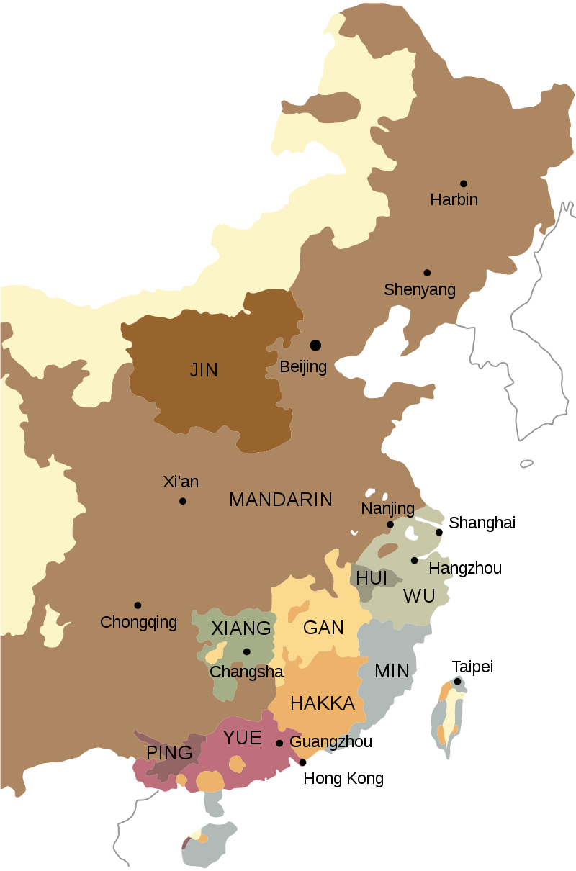
https://t.ly/QhD_
Notes:
Next we will have a brief look at the diminutives and lexical suprafixes in Pinghua and Yue dialects. Without giving an entire lecture on what Pinghua is, Pinghua and Yue basically lie on a dialect continuum, except that there are many Cantonese enclaves all along the dialect continuum. Standard Cantonese is spoken close to the eastern end of the dialect continuum, and there are many Cantonese speakers who shifted directly from the east to the west, forming Cantonese enclaves. These Cantonese enclaves are in contact with other languages in the area, like other Yue varieties, Pinghua, Mandarin, Zhuang, Vietnamese etc.

Slide 27
Diminutives / diminutive-like suffixes in Yuè dialects
https://t.ly/QhD_
Kao Wan-yu 高婉瑜 (2007), Kwok Bit-chee 郭必之 (2016)
-子 MC -tsi^{B} (‘child’)
-仔 MC -tsVj^{B} (‘child’)
-兒 MC -nye^{A} (‘male child’, later ‘child’)
-子 -tsi^{B} no obvious geographical pattern
-仔 -tsVj^{B} newer Cantonese / eastern form
(due to Cantonese, found to some degree throughout Yuè / Pínghuà)
-兒 -nye^{A} older form, common in the west
Notes:
There are three main diminutive suffixes amongst Yue and Pinghua dialects: tsi, tsej, and nye. Tsi is not used much in Cantonese, but there are Yue ad Pinghua dialects where tsi is used a lot. However, there is no obvious geographical pattern of where tsi is popular, soI won’t talk much about tsi. Tsej is a newer form that is found in standard Cantonese and other eastern Yue dialects. However, due to the strong influence of Cantonese, tsej is found to some degree in the West. nye as an older form that is commonly found in the west, but has largely disappeared in the east.

Slide 28
-子 -tsi^{B} (‘child’)
https://t.ly/GbxC
Mandarin: the use of 子 -zi is very common, e.g.
筷子 kuài-zi ‘chopsticks’
鴨子 yā-zi ‘duck’
被子 bèi-zi ‘quilt’
腦子 nǎo-zi ‘brain’ (colloquial)
(子 -zi: usually a “noun marker”, i.e. it adds no meaning to a noun stem)
Cantonese: the use of 子 tsi³⁵ is limited
筷子 fai³³-tsi³⁵ ‘chopsticks’
鴨 ap³ > ³⁵ ‘duck’
被 pʰei¹³ ‘quilt’
腦 nou¹³ ‘brain’
Notes:
The first suffix tsi. In Mandarin, the suffix -zi is very common, e.g. kuai-zi ‘chopsticks’, ya-zi ‘duck’, bei-zi ‘quilt’, nao-zi ‘brain’. Ususually -zi is a “noun marker”: it is added to a noun stem, but it usually contributes no meaning to the noun, other than saying that the word is a noun. In Cantonese, the use of tsi is limited. It is used in some words, for instance fai tsi ‘chopsticks’. The word for ‘duck’, ap35, is ap3 plus a suprafix. The suprafix is also a noun marker in this case. Otherwise, pʰei13, ‘quilt’, has no affix, nou13 ‘brain’ has no affix. In general, there are more monosyllabic words in Cantonese than Mandarin.

Slide 29
-子 -tsi^{B} (‘child’)
https://t.ly/GbxC
More common in some Yuè dialects,
e.g. Liánjiāng 廉江 (Zhān 詹 et al. 2002: 404–405)
蕉子 tsiu⁵⁵-tsi³⁵ ‘banana’
馬蹄子 ma¹³tʰɐi¹¹-tsi³⁵ ‘water chestnut’
Cf. Cantonese
蕉 tsiu⁵⁵ ‘banana’
馬蹄 ma¹³tʰɐi²¹ > ³⁵ ‘water chestnut’ (馬蹄 ma¹³tʰɐi²¹ ‘horse hoof’)
Notes:
The suffix tsi35 is not used much in Cantonese, but there are Yue dialects where tsi35 is more common, for instance in Liánjiāng in southwestern Guangdong. For instance tsiu55-tsi35 ‘banana’ and ma13 tʰɐi11-tsi35 ‘water chestnut’. In Cantonese these are tsiu55 and ma13 thɐi35, which is ma13 thɐi21 plus a suprafix.

Slide 30
-仔 -tsVj^{B} (‘child’)
https://t.ly/QhD_
Cantonese 仔 tsɐi˧˥
In isolation: ‘son’
As a suffix: all-purpose diminutive suffix
雀 tsœk ˧ > ˧˥ ‘bird’ > 雀仔 tsœk ˧ -tsɐi ˧˥ ‘little bird’
被 pʰei ˩˧ ‘quilt’ > 被仔 pʰei ˩˧ -tsɐi ˧˥ ‘little quilt’
Notes:
In Cantonese. The Cantonese form tsɐi35, in isolation it means ‘son’. As a suffix, it is the all purpose diminutive suffix in Cantonese. For instance, tsœk35 ‘bird’, tsœk3-tsɐi35 ‘little bird’; phei13 ‘quilt’, phei13-tsɐi35 ‘little quilt’. I don’t need give more examples, because you can stick tsɐi35 to basically all nouns.

Slide 31
-仔 -tsVj^{B} (‘child’)
https://t.ly/GbxC
Probably an old dialectal form of 子 tsi^{B}
Commonly written 仔 (MC tsi^{A} or tsjɨj^{B})
Often claimed to be etymologically 崽 (MC srɛ(j)^{A})
Can be reconstructed as tsɛj^{B} or tsej^{B} from Yuè & Pínghuà forms
Cantonese tsɐi˧˥
In isolation: ‘son’
As a suffix: all-purpose diminutive suffix
雀 tsœk ˧ > ˧˥ ‘bird’ > 雀仔 tsœk ˧ -tsɐi ˧˥ ‘little bird’
被 pʰei ˩˧ ‘quilt’ > 被仔 pʰei ˩˧ -tsɐi ˧˥ ‘little quilt’
Notes:
Next is the suffix tsɐi35. tsɐi35 is probably an old dialectal form of tsi35 which we talked about before. Presented here first are some etymological statements, which we do not need to discuss now. The Cantonese form tsɐi35, in isolation it means ‘son’. As a suffix, it is the all purpose diminutive suffix in Cantonese. For instance, tsœk35 ‘bird’, tsœk3-tsɐi35 ‘little bird’; phei13 ‘quilt’, phei13-tsɐi35 ‘little quilt’. I don’t need give more examples, because you can stick tsɐi35 to basically all nouns.

Slide 32
-兒 -nye^{A} (‘male child’ > ‘child’)
https://t.ly/QhD_
Cantonese
Noun root 兒 ji˨˩ (Lower tone A),
e.g. 兒童 ji˨˩ tʰʊŋ˨˩ ‘child’ (literary expression)
As a suffix (in high level suprafix ji⁵⁵ ) only in fossilised forms
乞兒 hɐt˥ -ji˨˩ > ˥ (beg-dim) ‘beggar’
捉兒人 tsʊk˥ -ji˨˩ > ˥ jɐn˨˩ > ˥ (catch-dim person) ‘hide and seek’
貓兒 mau˥ ji˨˩ > ˥ (cat-dim) ‘kitten’
(c.f. nursery rhyme: 排排坐，食粉粿，貓兒擔凳畀姑婆坐，坐爛個屁股唔好賴我
c.f. idiom: 老狗嫩貓兒，食死冇人知)
-nye Very common in western Yuè and Pínghuà
Notes:
The form ji4 is used in literary expressions like ji4 tung4 children’ . There is also a suffix ji1, with a high level suprafix, which is only found in fossilised forms., for example hat1 ji1 ‘beggar’, zuk1 ji1 jan1 ‘hide and sea’, maau1 ji1 ‘kitten’ which is only heard in some rather old sayings.

Slide 33
https://t.ly/QhD_
In 南寧 Nánníng, schematically
(de Sousa 2015):
Northern Zhuàng
(indigenous; Tai)
Southern Zhuàng
(indigenous; Tai)
Pínghuà
(1000+ years; Sinitic)
Cantonese
(≈150 years; Sinitic)
Yōng River
邕江
(> West River
> Pearl River)
*Old Nan. Mand.
*Old Nan. Mand.
(*Old Nánníng Mandarin 邕州官話 (less than 500 years), used to dominate the city centre but now moribund there)
Notes:
Next I will talk a little bit about the situation in Nanning, the capital of Guangxi, upriver to the west of Canton. There are many languages spoken in Nanning, and I will only talk about Nanning Cantonese, spoken in the city centre, and Nanning Pinghua, spoken in the surrounding suburbs. There is no standard Pinghua, and there are substantial differences amongst the Pinghua varieties spoken in the various suburbs. I did my fieldwork in the northwestern suburbs.

Slide 34
Nánníng Cantonese (Lín Yì 林亦 & Qín Fèngyú 覃凤余 2008: 14)
6 tonemes: / ˥ / / ˧˥ / / ˧ / / ˨˩ / / ˨˧ / / ˨ /
 | *A | *B |  | *C | *D, L | *D, S
*voiceless | ˥ | ˧˥ |  | ˧ | ˧ | ˥
*voiced | ˨˩ | ˨˦ | ˨ |  | ˨
Nánníng Wèizǐlù Pínghuà
7 tonemes: / ˥˧ / / ˧ / / ˧˥ / / ˥ / / ˨˩ / / ˩˧ / / ˨ /
Old Nánníng Mandarin
4 tonemes: / ˧˥ / / ˧˩ / / ˥˦ / / ˩˧ /
 |  | *A | *B |  | *C | *D
*voiceless | + asp | ˥˧ | ˧ |  | ˧˥ | ˧
 | – asp |  |  |  | ˥
*voiced | *son | ˨˩ | ˩˧ | ˨ |  | ˨˧
 | *obs |  |  |  |  | ˨
 | *A | *B |  | *C | *D
*voiceless | ˧˥ | ˥˦ |  | ˩˧ | ˧˩
*voiced | ˧˩
(Irregular D: ˥, ˨)
(Irregular D: ˥)
Notes:
It is not necessary to understand these tone correspondences, but this is it if this is what you want to know. The only thing is that Nanning Cantonese basically has the same tones as Standard Cantonese, and the variety of Nanning Pinghua that I mainly worked on has these seven tonemes.

Slide 35
Nánníng Cantonese
https://t.ly/GbxC
子 -tʃi³⁵: similar to Standard Cantonese子 -tsi³⁵
Not used much; usually a “noun marker”
仔 -tʃɐi³⁵: similar to Standard Cantonese 仔 -tsɐi³⁵
All-purpose diminutive suffix
兒 -ji²¹ > ⁵⁵: similar to Standard Cantonese 兒 -ji²¹ > ⁵⁵
Fossilised in some words
e.g. 乞兒 hɐt⁵ ji²¹ > ⁵⁵ (beg-dim) ‘beggar’
Notes:
There are the suffixes -tʃi35, -tsɐi35, and -ji55 in Nanning Cantonese, and there uses are basically the same as in Standard Cantonese.

Slide 36
Nánníng Cantonese
https://t.ly/GbxC
Suprafixes: 35, 55 (,21); used much less often than Standard Cantonese
some examples (including counterexamples):
Nánníng Cantonese | Standard Cantonese
枱 tʰɔi²¹ ‘table’ | 枱 tʰɔi²¹ > ³⁵ ‘table’
枱布 tʰɔi²¹ pu³³ ‘table cloth’ | 枱布 tʰɔi²¹ > ³⁵ pou³³ ‘table cloth’
阿妹 a³³-mui²² > ³⁵ (name-y.sis) ‘younger sister’ | 阿妹 a³³-mui²² > ³⁵ (name-y.sis) ‘younger sister’
細妹 ɬɐi³³ mui²² (small y.sis) ‘youngest sister’ | 細妹 sɐi³³ mui²² > ³⁵ (small y.sis) ‘youngest sister’
妹仔 mui²² > ⁵⁵-tʃɐi³⁵ (y.sis-dim) ‘female servant’ | 妹仔 mui²² > ⁵⁵-tsɐi³⁵ (y.sis-dim) ‘female servant’
畀面 pi³⁵ min²² > ³⁵ ‘give face’ | 畀面 pei³⁵ min²² > ³⁵ ‘give face’
面子 min²² > ³⁵-tʃi³⁵ (face-noun) | 面子 min²²-tsi³⁵ (face-noun)
堡壘 pu³⁵ lui²⁴ > ⁵⁵ ‘fortress’ | 堡壘 pou³⁵ lɵy¹³ ‘fortress’
Notes:
As for suprafixes, Nanning Cantonese has the same three suprafixes as Standard Cantonese. However, they are used much less often in Nanning Cantonese. Just looking at the first two examples. ‘Table’, and ‘table cloth’ are thɔi21, thɔi21 pu33 without suprafixes in Nanning. In Standard Cantonese in Hong Kong and Canton, they are thɔi35 and thɔi35 pou33, with a suprafix on thɔi35.

Slide 37
Nánníng Pínghuà
https://t.ly/GbxC
Nán. Cantonese 子 -tʃi³⁵: limited use, similar to Standard Cantonese
Nán. Pínghuà 子 -tʃi³³: very common,
perhaps more common than Mandarin -zi
Nánníng Pínghuà | Nánníng Cantonese | Standard Cantonese
毫子 hau²¹-tʃi³³ ‘0.1 Yuán’ | 毫子 hu²¹-tʃi³⁵ ‘0.1 Yuán’ | 毫子 hou²¹-tsi³⁵ ‘0.1 Yuán’
鉗子 kɛm²¹-tʃi³³ ‘pliers’ | 鉗 kʰɛm²¹ ‘pliers’ | 鉗 kʰim²¹ > ³⁵ ‘pliers’
星子 ɬən⁵³-tʃi³³ ‘star’ | 星 ɬeŋ⁵⁵ ‘star’ | 星 sɪŋ⁵⁵ ‘star’
蕉子 tʃiu⁵³-tʃi³³ ‘banana’ | 蕉 tʃiu⁵⁵ ‘banana’ | 蕉 tsiu⁵⁵ ‘banana’
◯子 pʊk²-tʃi³³ ‘pomelo’ (< N. Zhuàng lwg-bug) | ◯◯ puk⁵luk⁵ ‘pomelo’ | ◯柚 lʊk⁵-jɐu²² > ³⁵ ‘pomelo’
Notes:
Now to Nanning Pinghua. Unlike Nanning Cantonese, where the suffix -tʃi35 is rarely used, in Nanning Pinghua the suffix -tʃi33 is very common. Perhaps even more common than -zi in Mandarin. Just taking the second item ‘pliers’ as an example. Nanning Pinghua says kɛm-tʃi, with a -tʃi suffix. Nanning Cantonese says khɛm, with no affix. Standard Cantonese says khim35, with a high rising suprafix.

Slide 38
Nánníng Pínghuà
https://t.ly/QhD_
Diminutives:
兒 -ɲi˨˩
兒 -ɲi ˨˩ > ˥˧
仔 -tʃai ˧ (< newer Cantonese loan)
Not widely used
the suffix used is lexically determined
(one could always use an adjective 細 ɬɐi˥ ‘small’ instead)
Notes:
As for diminutive suffixes, Nanning Pinghua has three diminutives: -ɲi21 in citation tone, -ɲi53 with a high falling suprafix, and -tʃai33. Looking at other Pinghua varieties, -tʃai33 is a newer Cantonese loan. Dimunitives are not used a lot in Nanning Pinghua, and the suffix used is lexically determined.

Slide 39
Nánníng Pínghuà
https://t.ly/QhD_
e.g.:
 | 兒 -ɲi˨˩ | 兒 -ɲi ˨˩ > ˥˧ | 仔 -tʃai ˧
雞 kɐi˥˧ ‘fowl’ | ✅ |  | ✅
狗 kɐu ˧ ‘dog’ | ✅ | (✅) | (✅)
羊 jɐŋ˨˩ ‘goat’ | ✅
豬 tʃəi˥˧ ‘pig’ |  |  | ✅
車 tʃʰɛ˥˧ ‘car’ | ✅ | ✅ | ✅
刀 tau˥˧ ‘knife’ | ✅ |  | ✅
燈 tɐŋ˥˧ ‘lamp’ |  | ✅ | ✅
屋 ʊk˧ ‘house’ |  | ✅
鐺 tʃʰɛŋ˥˧ ‘wok’ |  | ✅
碗 un˧ ‘bowl’ |  |  | ✅
Notes:
For example the first item, a chick is kɐi53-ɲi21 or kɐi53-tʃai33, not kɐi53-ɲi53. The last two items, a small wok is tʃhɛŋ53-ɲi53, but a small bowl, is un33-tʃai33, not un33-ɲi53 or un33-ɲi21.

Slide 40
Nánníng Pínghuà
https://t.ly/QhD_
Suprafixes: infrequent high falling ˥˧ , mostly in the diminutive suffix 兒 -ɲi˨˩ > ˥˧
Cantonese-like examples (Cantonese has ˥ suprafix for these):
文 mɐn˨˩ > ˥˧ ‘Yuán’, 米 mɐi ˩˧ > ˥˧ ‘metre’, 荷蘭 hɔ˨˩ lan ˨˩ >˥˧ ‘Holland’
Other examples:
歌詞 ka˥˧ tʃi˨˩ > ˥˧ ‘love song lyrics’ (vs. 歌詞 kɔ˥˧ tʃi˨˩ ‘song lyrics’)
(ka˥˧ is a genre of songs)
大娘 tai ˨ -nɛŋ˨˩ > ˥˧ (big-lady) ‘paternal grandfather’s senior wife’
細娘 ɬɐi ˥ -nɛŋ˨˩ > ˥˧ (small-lady) ‘paternal grandfather’s junior wife’
(vs. 阿娘 a˥-nɛŋ ˨˩ (name-lady) ‘paternal grandmother’)
老娘 lau˩˧ -nɛŋ˨˩ > ˥˧ (old-lady) ‘mother’
Notes:
As for suprafixes, they don’t occur a lot in Nanning Pinghua. Most cases involve a high falling suprafix 53, and most usually it is on the diminutive suffix -ɲi53. The following are some other examples. Looking at the last two lines. Your paternal grandmoter is a55-nɛŋ21, with no suprafix, but your mother is lau13-nɛŋ53, with a high falling suprafix.

Slide 41
Nánníng Pínghuà
https://t.ly/QhD_
Non-˥˧ suprafixes:
姨娘 həi˨˩ -nɛŋ ˨˩ (> ˥) ‘mother’s younger sister’
雀 tʃɛk ˧ > ˥ ‘bird’
雀兒 tʃɛk ˧ > ˥ -ɲi˨˩ ‘little bird’
(vs. 孔雀 kʰʊŋ ˧ tʃʰɛk ˧ ‘peacock’
(Old Nánníng Mandarin 雀 tsʰo˧˩ ‘bird’, Standard Mandarin 雀 què
Nánníng Cantonese 雀 tʃʰœk ˧ , Standard Cantonese 雀 tsœk ˧ > ˧˥; MC tsjak^{D}))
爺爺 jɛ˨˩ jɛ ˨˩ > ˧˥ ‘paternal grandfather’ (< Cantonese)
奶奶 nai˩˧ > ˥ nai ˩˧ > ˥ ‘paternal grandmother’ (< Mandarin)
Notes:
The following are examples of suprafixes that are not high falling 53, but these are very rare, and I will skip these

Slide 42
https://t.ly/GbxC
(Modern) Sinitic languages:
Morphologically “isolating”
Very few affixes, mostly etymologically transparent
(Sagart 2004)
Affixes are mostly entire syllables
(Ansaldo, Bisang & Szeto 2018)
However, sub-syllabic affixes, e.g.: verbal sub-syllabic affixes in Northern Sinitic (Lamarre 2015, Acordia 2015)
verbal and pronominal sub-syllabic affixes in Sinitic
(Chappell forthcoming)
Notes:
The modern Sinitic languages are said to be morphologically isolating, meaning that there are few afixes, and they are mostly etymologically transparent. Affixes are mostly entire syllables. However, phonetic erosion does occur in Sinitic languages, and an affix can be smaller than a syllables, for instance just a tone, or the substitution or addition of a segment within the stem syllables.

Slide 43
https://t.ly/QhD_
Cantonese:
non-lexical suprafixes
(Kwok Bit-chee 郭必之 2009)
lexical suprafixes
(Maurice Wong 1982; Alan Yu 2007)
(amongst many others)
Diminutives and suprafixes in Yuè in general:
Zhōu Liètíng 周烈婷 (2002:154–171)
Kao Wan-yu 高婉瑜 (2007)
Chén Xiǎoyàn 陈小燕 (2007: 267–275)
Shào Huìjūn 邵慧君 & Gān Yū’ēn 甘于恩 (2007a,b)
Kwok Bit-chee 郭必之 (2016)
Notes:
Now, what is the link between the east and the west, in terms of the diminutives and the lexical suprafixes.
There have already been many studies on the suprafixes in Cantonese and Yue dialects in general, these are some of them.

Slide 44
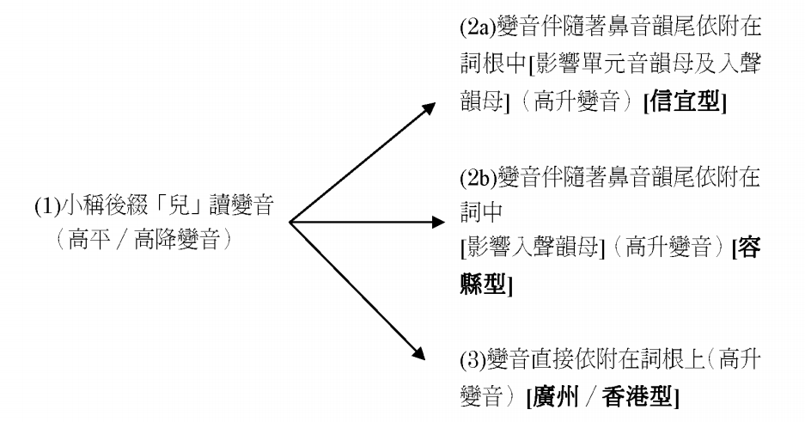
Nominal suprafix and diminutives
https://t.ly/QhD_
Kwok Bit-chee 郭必之 on Yuè dialects (2016: 306)
(2a) -N↗︎
[Xìnyí]
(2b) -N↗︎
[Róng]
(1) Diminutive suffix 兒 nye^{A}
pronounced with suprafix
(high flat / high fall suprafix)
(3) Suprafix directly attached to root
(high rise suprafix)
[Canton / Hong Kong type]
Notes:
Kwok Bit-Chee 2016 provided a model of the development from the diminutive suffix nyi4 to the Cantonese lexical suprafix. However, he only looked at the situation with the Yue dialects, and did not look further westward into the Pinghua dialects,

Slide 45
Nominal suprafix and diminutives
https://t.ly/QhD_
Looking at Pínghuà (and some western Yuè dialects):
(0) Diminutive suffix 兒 nye^{A}
in its original Lower tone A
(1) Diminutive suffix 兒 nye^{A}
pronounced with suprafix
(high flat / high fall suprafix)
(3) Suprafix directly attached to root
(high rise suprafix)
[Canton / Hong Kong type]
Notes:
and has hence missed a preceding step. I shall start talking this story from the preceding step in Pinghua dialects.

Slide 46
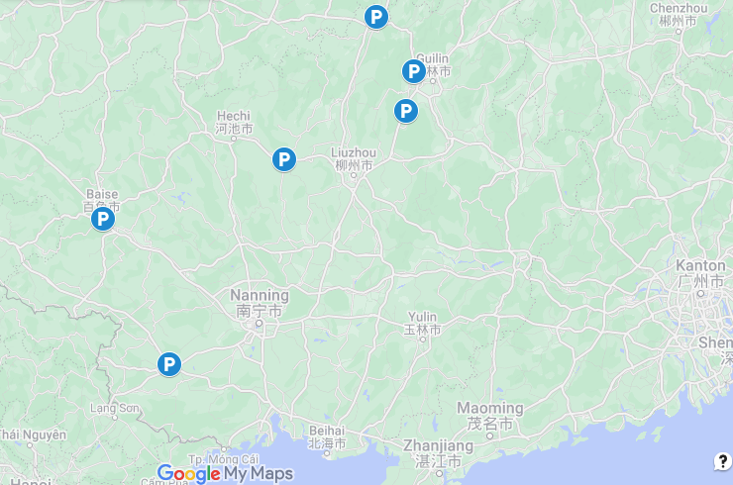
Sānjiāng Liùjiáhuà
三江 六甲話
-ɲi31 L.A
Línguì Wǔtōng
臨桂 五通
-ɲi31 L.A
Yǒngfú Táochéng
永福 桃城
-ɲi23 L.A
Yízhōu Déshèng
宜州 得勝
-ŋi31 L.A
Exampels of Pínghuà dialects with a
兒 nye^{A} diminutive suffix
in Lower tone A (the expected reflex)
(The norm amongst Pínghuà varieties)
Bǎisè Nàbì
百色 那畢
-ɲi31 L.A
Chóngzuǒ Jiāngzhōu
崇左 江州
-ɲi32 L.A
Notes:
The norm for Pinghua dialects is to have a nye diminutive suffix in its original Lower tone A. Like Cantonese, the Lower tone A is phonetically low in Pinghua dialects.

Slide 47
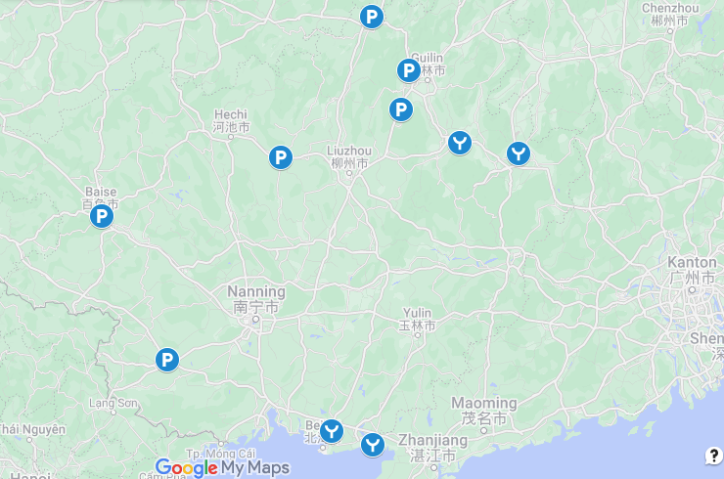
(*Qín Yuǎnxióng 覃遠雄 2019: Běndìhuà is
recently Mandarinised Yuè, not Pínghuà)
Zhōngshān Běndìhuà
鍾山 本地話
-ɲi23 L.A
Pínglè Běndìhuà
平樂 本地話
-ɲi31 L.A
Some western Yuè dialects also have
兒 nye^{A} diminutive suffix
in Lower tone A (the expected reflex)
Hépǔ (Liánzhōu)
合浦 (廉州)
-ŋi44 L.A
Hépǔ Shātián
合浦 沙田
-ŋi55 L.ABC ºD
Notes:
Actually some western Yue dialects are also like this, with nye in lower tone A. For example, Pingle and Zhongshan in the north. In the South Hepu Lianzhou has ŋi44 in lower tone A. ŋi44 is already quite high, but it is not the highest tone in Hepu. Hepu Shatian is complicated. ŋi55 is indeed in lower tone A, but 55 is already the highest tone, and also lower tone A has merged with lower B, lower C, and obstruent lower D, so it is impossible to tell whether there had been any change in tonal category from the original lower tone A or not.

Slide 48
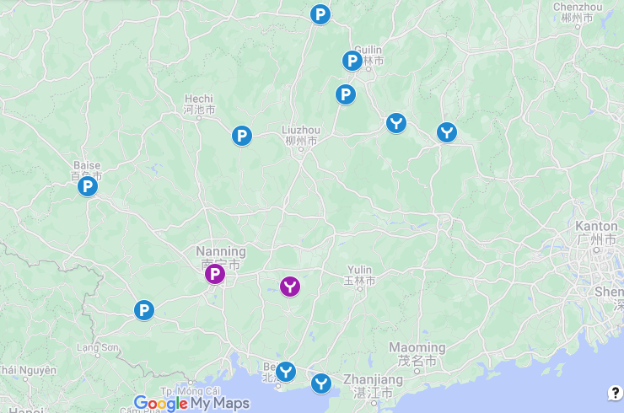
Nánníng Wèizǐlù
南寧 位子碌
-ɲi21 L.A
-ɲi53 (U.A)
Héngzhōu Cantonese
橫洲 白話
-ɲi232 L.A
-ɲi55 (U.A)
Some Pínghuà / Yuè varieties have one
兒 nye^{A} diminutive suffix in
Lower tone A (the expected reflex)
and another with a high tone suprafix
Notes:
Then there are for instance Nanning Weizilu Pinghua, that I did my fieldwork on, and also Hengzhou Cantonese to the east, where they have a nye diminutive suffix in its original lower tone A, and also a nye diminutive suffix in a high tone. Why would a diminutive suffix develop a high tone version? This has to do with iconicity; small things emit high pitch. It is not suprising that a low tone dimunitive develops a high tone version; it is more iconic for a diminutive to be in a high tone. Looking at data from Pinghua and western Yue dialects, a high tone suprafix developes first in a diminutive suffix, and then afterwards you see more and more noun stems taking a high tone suprafix themselves.

Slide 49
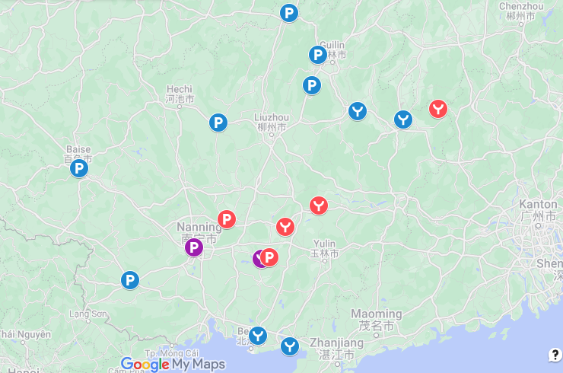
Hèzhōu Guìlǐng
賀州 桂嶺
-ŋi52 (U.A)
Some Pínghuà / Yuè varieties
only have the 兒 nye^{A} diminutive suffix
in a high tone suprafix
Bīnyáng Xīnqiáo
賓陽 新橋
-ŋi55 (U.C)
Guìpíng Cantonese
桂平白話 -ŋi55 (U.A)
Guìgǎng 貴港
-ŋi55 ~ -ɲi55 (U.A)
Héngzhōu Lǐngliáo
橫洲 嶺鷯
-ji24 (U.A)
Notes:
Further east, some Pinghua and Yue dialects have the nye diminutive suffix only in a high tone, for instance the Pinghua of Binyang and Hengzhou, and also the Yue dialects in Guigang, Guiping, Hezhou.

Slide 50
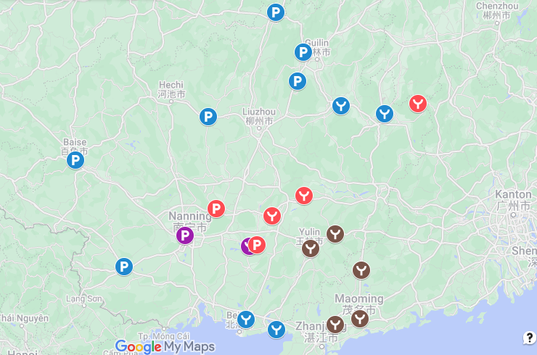
Some Yuè varieties have -N^{H}
Róng Xiàn
容縣
Yùlín
玉林
Xìnyí
信宜
Màomíng
茂名
Huàzhōu Liángguāng
化州 良光
Notes:
Further east in southeastern Guangxi, and also in neighbouring southwestern Guangdong, the nye suffix is sometimes further eroded to just a nasal consonant, and sometimes just a high tone.

Slide 51
-N^{H} (nasal suffix in high tone) > -^{H}
https://t.ly/GbxC
Huàzhōu Liángguāng 化州良光 Yuè (Kwok Bit-chee 郭必之 2016)
Usually a separate syllable -N^{H}
手兒 (sɐu³⁵ -ŋ²³ >) sɐu³⁵ -ŋ⁵³ (hand-dim) ‘finger’
銀兒 (ŋɐn²³ -ŋ²³ >) ŋɐn²¹ -ŋ⁵³ (silver-dim) ‘coin’
乞兒 (hak⁵ -ŋ²³ >) hak⁵ -ŋ⁵³ (beg-dim) ‘beggar’
腳兒 (kiɛk³ -ŋ²³ >) kiɛŋ³⁵ -ŋ⁵³ (leg-dim) ‘leg’
正下兒 tseŋ³³ ha²¹ -ŋ²³ > tseŋ³³ haŋ³⁵ ‘a while’
鵝 ŋɔ²³ > ŋɔ⁵³ ‘goose’
販子 fan³³-dei³⁵ (sell-dim) ‘hawker, peddler’ (子 -dei³⁵: inspired by Hakka)
煙仔 jin⁵³-dɐi³⁵ (tobacco-dim) ‘cigarette’ (仔 -dɐi³⁵: inspired by Cantonese)
Notes:
For example, in Huazhou, older speakers have a diminutive suffix which is just a nasal consonant, usually still as a separate syllable. For instance, the first example, hand diminutive is sɐu35 ŋ53, still two syllables. The fourth example, leg diminutive is kiɛŋ35 ŋ53, with kiɛk ‘leg’, assimilated by the following nasal suffix.

Slide 52
-N^{H} (nasal suffix in high tone) > -^{H}
https://t.ly/GbxC
Màomíng 茂名 Yuè (Shào Huìjūn 邵慧君 & Gān Yū’ēn 甘于恩 2007b)
-ɲi⁵⁵ or (N)↗︎ [↗︎: rise to very high, often falsetto]
豬兒 tʃi⁵⁵ -ɲi⁵⁵ / tʃin↗︎ (pig-dim) ‘piglet’
勺兒 ʃiak²²-ɲi⁵⁵ / ʃiaŋ↗︎ (spoon-dim) ‘spoon’
印兒 jɐn³³ -ɲi⁵⁵ / jɐn↗︎ (mark-dim) ‘ink stamp’
雞兒 kɐi⁵⁵ -ɲi⁵⁵ / kɐi↗︎ (fowl-dim) ‘chick’
Notes:
In Maoming, they alternate between a full syllable ɲi55, and a nasal plus an extra high rising suprafix. For instance, the first example, a piglet is either tʃi-ɲi or tʃin. The last example, a chick is either kɐi55-ɲi55 or kɐi. In this case the phonotactics does not allow the first syllable to have an extra nasal.

Slide 53
-N^{H} (nasal suffix in high tone) > -^{H}
https://t.ly/GbxC
Xìnyí 信宜 Yuè (Zhān Bóhuì 詹伯慧 et al. 2002: 204)
primarily (N)↗︎ [↗︎: rise to very high, often falsetto]
魚 ɲy¹³ ‘fish’ > ɲyn↗︎ ‘little fish’
亞叔 a³³ sok⁵⁵ (dad.y.bro) ‘uncle’ > a³³ soŋ↗︎ ‘little uncle’
狗 kɐu²⁴ ‘dog’ > kɐu↗︎ ‘little dog’
豬 tʃy⁵³ ‘pig’ (Shào Huìjūn 邵慧君 & Gān Yū’ēn 甘于恩 2007b)
豬 tʃyn↗︎ (pig\dim) ‘little pig’
豬兒 tʃy⁵³-ɲi⁵³ (pig-dim) ‘newborn piglet’
豬兒 tʃy⁵³-ɲin↗ (pig-dim\dim)
Róng County 容縣 Yuè (Zhōu Zǔyáo 周祖瑤 1987)
鋼筆 koŋ²² pɐt⁵ > koŋ²² pɐn³⁵ (steel pen) ‘fountain pen’
豬 tsy⁵⁵ ‘pig’ > tsy³⁵ ‘little pig’
Notes:
Xinyi primarily uses the nasal plus suprafix strategy. We’ll skip to the fourth example, tʃy53 is pig, tʃyn is little pig. They actually also have the full syllable suffix ɲi53, but it only has the meaning a newborn child, so tʃy53 ɲi53 is a newborn piglet. This diminutive form has a dimunitive form tʃy53-ɲin, but I don’t know whether this means something different from the preceding example or not. The next examples from Rong County I will skip, Rong County is similar to Xinyi.

Slide 54
https://t.ly/GbxC
Yùlín 玉林 Yuè (Zhōu Liètíng 周列婷 2002)
six tonemes: 55 33 52 32 24 11 || 4 3 2 1
with suprafix: 44 35 35 34 34 34 || 44 35 34 34
(In the examples below: tone changes in the first syllable is tone sandhi,
tone changes in the second syllable is diminutive suprafix)
侄兒 tsat²² > ¹¹ ɲi³² ‘brother’s son’ (兒 ɲi³² in citation tone (Lower tone A))
阿侄 a³³ tsat²² > a³³ tsan³⁴ ‘brother’s son’
雀兒 ta³³-ɲi⁵⁵ (bird-dim) (兒 ɲi⁵⁵ in a high tone (Upper tone A))
雞兒 kai⁵⁵-ɲi⁵⁵ > kai³³ ɲi⁴⁴ (fowl-dim) (兒 ɲi⁴⁴ in suprafixed Upper tone A)
羊兒 ja³²-ɲi⁵⁵ > ja¹¹-ɲi⁴⁴ (goat-dim)
年頭 nin⁵⁵ > ⁵² tau³² (year head) ‘beginning of year’
年尾 nin⁵⁵ > ³³ mi³³ (year tail) ‘end of year’
明年 mɛŋ³² nin⁵⁵ > mɛŋ¹¹ nin⁴⁴ ‘next year’
Notes:
These examples from Yulin I will skip, because Yulin is an absolute boss fight.

Slide 55
Notes:
East of this, other than some odd spots, the suffix nye is not found. In Yangjiang they use a lot of the suffix tsi, but otherwise the east primarily uses tsɐi as the dominant diminutive suffix.

Slide 56
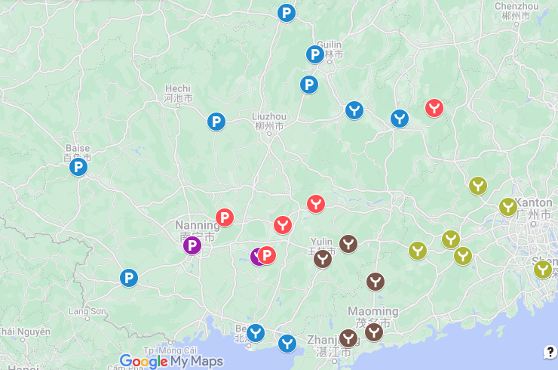
Some Yuè varieties
close to Canton that uses suprafixes
less often than Cantonese
(Zhān Bóhuì 詹伯慧
et al. 2002: 179–180, 198)
Guǎngníng
廣寧
Sìhuì
四會
Yúnfú
雲浮
Luódìng
羅定
Xīnxīng
新興
Zhōngshān
中山
Notes:
There are explicit statements saying that there are these Yue dialects close to Canton that use much fewer suprafixes than Cantonese. Older speakers in Macau are like that, Nanning Cantonese is also like that. So where did the suprafixes in Standard Cantonese come from? We don’t actually know for sure. But looking at the tones of Cantonese more than 100 years ago, it does suggest that the suprafixes in Cantonese came a suffix.

Slide 57

https://t.ly/QhD_
So where did the Cantonese lexical suprafixes come from?
There is no written record (?) of what the lexical suprafixes were contractions of
Notes:
So where did the floating high tone suprafix on nouns come from? What was the identity of the suffix that contributed the floating high tone. We don’t know. There is no written roecord of what the nominal suprafix was a contraction of. With verbal suprafixes, we know what verbal particles the suprafixes alternate with, but with the nominal suprafixes, we don’t actually know.

Slide 58
https://t.ly/QhD_
兒 nye^{A}?
e.g. Mài Yún 麦耘 (1990), Zhōu Liètíng 周烈婷 (2002: 154–171), Chén Xiǎoyàn 陈小燕 (2007: 267–275) Kwok Bit-chee 郭必之 (2016)
兒 nye^{A} diminutive is the source of the lexical suprafixes in western Yuè dialects
The (very few) fossilised cases of 兒 -ji˥ in modern Cantonese
However,
There is no a priori reason why eastern Yuè dialects must have followed the same path as the western Yuè dialects
The range of nouns with a suprafix in Standard Cantonese does not overlap much with that with a -nye suffix in western Yuè dialects
(Shào Huìjūn 邵慧君 & Gān Yū’ēn 甘于恩 2007b)
Notes:
The usual theory is that the nominal suprafixes in Cantonese came from nye. From west to east along the dialect continuum, we have seen that the nye suffix in high tone has gradually experienced phonetic erosion. In Standard Cantonese in the east, there is only a high tone left, and there are very few fossilised cases of the ji55 suffix.
However, the problem with this theory is that there is no a priori reason why the eastern Yue dialects must have followed the same path as the western Yue dialects. If you ask me, personally I doubt that Yue is valid genealogical subgroup. And as pointed out by Shao Huijun, the nouns with a suprafix in Standard Cantonese does not overlap very much with those with a nye suffix in the western Yue dialects.

Slide 59
https://t.ly/QhD_
仔 tsVj^{B}?
Kwok Bit-chee 郭必之 (2016): unlikely
Although the rising tone of Cantonese 仔 tsɐi˧˥ does coincide with the high rising suprafix in Cantonese, most Yuè dialects have 仔 tsVj^{B} in a rising tone, but their suprafixes are mostly high level or high falling.
Ball (1888): 仔 tsɐi˧˥ already a commonly used diminutive suffixes,
but 仔 tsɐi˧˥ did not have a suprafix, e.g.:
檯仔 t’oi2* tsai2 ‘little table’ (: 41)
However,
There is no a priori reason why the development in Cantonese has to be the same as in other Yuè dialects
Notes:
Is tsai the origin of the Cantonese nominal suprafixes? The tone of tsai does coincide with the high rising suprafix in Cantonese. However, as argued by Kwok, tsai is unlikely the source of the high tone suprafixes. tsai has a high rising tone in most Yue dialects, but the suprafixes are mostly high level or high falling in most Yue dialects. However, again, that a theory does not make sense for some other Yue dialects does not mean that it cannot be valid for Standard Cantonese. One can not yet dismiss the theory that tsɐi35 is the origin, or one of the origins, of the suprafixes in eastern Yue dialects. In fact Kwok himself gave three examples of alternations between the high rising suprafix and the suffix tsai in Cantonese.

Slide 60
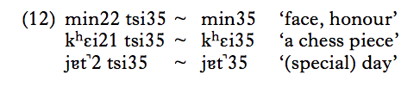
https://t.ly/QhD_
子 tsi^{B} diminutive?
e.g. Maurice Wong (1982), quoted by Alan Yu (2007: 202)
However:
these loans from literary Chinese
(and there are very few such pairs)
Notes:
What about the tsi suffix? Maurice Wong (1982) gives examples of alternation between tsi and the high rising suprafix. However, these words with tsi are most probably Mandarin loans, and there are very few such pairs which alternate between tsi and the high rising suprafix. There are Yue and Pinghua dialects which use a lot of tsi, but in and around Canton, tsi is not used much, and tsi is unlikely the source of the suprafixes in Cantonese.

Slide 61
Conclusion
https://t.ly/QhD_
There is no clear prove of where the Cantonese lexical suprafixes came from.
(Although the 兒 -nye^{H} hypothesis remain the most plausible.)
There has been increase in the use of the high rising lexical suprafix in Hong Kong Cantonese in the last 130 years.
Along the Pínghuà–Yuè dialect continuum:
the dominant diminutives (from west to east) are:
兒 nye^{L} – 兒 nye^{H} ( – N^{H} ) – 仔 tsVj^{H}
lexcial suprafixes are the most developed in Standard Cantonese in the east

Slide 62
bibliography
Ball, James Dyer. 1888. Cantonese made easy: A book of simple sentences in the Canton dialect. 2nd edn. Hong Kong: China Mail Office.
Bì, Sīmíng 闭思明. 2003. Jì Guǎngxī Héngxiàn Pínghuà de yǔzhuì 记广西横县平话的语綴 [On the affixes in Guangxi Hengxian Pinghua]. Journal of Wuzhou Teachers College of Guangxi 广西梧州师范高等专科学校学报 19(2). 17–18, 63.
Ch’an, Chan Sene. 1900. Rules for the use of the variant tones in Cantonese. China Review 24(5). 209–226.
Chén, Xiǎojǐn 陈晓锦 & Tāo Chén 陈滔. 2005. Guǎngxī Běihǎishì Yuèfāngyán diàochá yánjiū 广西北海市粤方言调查研究 [Investigative studies of the Yue dialects in Beihai City, Guangxi]. Beijing: China Social Science Press 中国社会科学出版社.
Chén, Xiǎojǐn 陈晓锦 & Zéwén Wēng 翁泽文. 2010. Yuèyǔ xīyì kǎochá: Guǎngxī Guìgáng Yuèyǔ zhī gè’àn yánjiū 粤语西翼考察：广西贵港粤语之个案研究 [Inspections on the western wing of Yue: studies on the case of Guangxi Guigang Yue]. Guangzhou: Jinan University Press 暨南大学出版社.
Chén, Xiǎoyàn 陈小燕. 2007. Duō zúqún yǔyán de jiēchù yǔ jiāoróng: Hèzhōu Běndìhuà yánjiū 多族群语言的接触与交融: 贺州本地话研究 [Contact and interactions between multiple ethnolinguistic groups: studies of Hezhou Bendihua]. Beijing: The Ethnic Publishing House 民族出版社.
Chen, Zhongmin. 1999. The common origin of diminutives in southern Chinese dialects and Southeast Asian languages. Linguistics of the Tibeto-Burman Area 22(2). 21–47.
Kao, Wan-yu 高婉瑜. 2007. Lùn Yuèyǔ xiǎochēngcí jí qí yǔfǎhuà 論粵語小稱詞及其語法化 On the diminutives in Yue dialect and their grammaticalization. Bulletin of The Department of Chinese Literature, National Taiwan University 臺大中文學報 27. 229–262.

Slide 63
Kwok, Bit-Chee 郭必之. 2009. Zǎoqī Guǎngzhōuhuà de yǔfǎ biànyīn – Cóng Ch’an (1900) Tánqǐ 早期廣州話的語法變音 – 從 Ch’an (1900) 談起 Tone change in early Cantonese as revealed in Ch’an (1900). Bulletin of Chinese Linguistics 中國語言學集刊 3(2). 169–184.
Kwok, Bit-Chee 郭必之. 2016. Yuèyǔ fāngyán xiǎochēng biànyīn de lèixíng jí qí lìshǐ láiyuán 粵語方言小稱變音的類型及其歷史來源 Diminutive sound changes in the Yue dialects: typology and historical origins. Chinese Studies 漢學研究 34(2). 281–314.
Lǐ, Liánjìn 李连进 & Yàn’é Zhū 朱艳娥. 2009. Guǎngxī Chóngzuǒ Jiāngzhōu Zhèyuánhuà bǐjiào Yánjíū 广西崇左江州蔗园话比较研究 [Comparative study of Guangxi Chongzuo Jiangzhou Sugar-Cane Plantation Language]. Guilin: Guangxi Normal University Press 广西师范大学出版社.
Lín, Yì 林亦 & Fèngyú Qín 覃凤余. 2008. Guǎngxī Nánníng Báihuà yánjiū 广西南宁白话研究 [Studies on Guangxi Nanning Cantonese]. Guilin: Guangxi Normal University Press 广西师范大学出版社.
Lamarre, Christine. 2015. The morphologization of verb suffixes in Northern Chinese. In Guangshun Cao, Redouane Djamouri & Alain Peyraube (eds.), Language contact in North-Western China, 275–307. Paris: École des hautes études en sciences sociales.
Mài, Yún 麦耘. 1995. Guǎngzhōuhuà de yǔsù biàndiào jí qí láiyuán hé shànbiàn 广州话的语素变调及其来源和嬗变 [Morphological tone change in Cantonese and its origin and evolution]. In Yún Mài 麦耘, Yìnyùn yǔ fāngyán lùnjí 音韵与方言论集 [Collected papers on phonology and dialects], 241–282. Guangzhou: Guangdong People’s Publishing House 广东人民出版社.
Qín, Fèngyú 覃凤余, Dōngshēng Qín 覃东生 & Chūnlái Tián 田春来. 2016. Xiàpiān: Pínghuà de yǔfǎ yánjiū 下篇 平话的语法研究 [Lower section: grammatical studies of Pinghua]. In Jǐn Yú 余瑾 (ed.), Guǎngxī Pínghuà Yánjiū 广西平话研究 [Studies on Guangxi Pinghua], 281–426. Beijing: China Social Science Press 中国社会科学出版社.
Shào, Huìjūn 邵慧君 & Yū’ēn Gān 甘于恩. 2007a. Yuèyǔ xiǎochēng biànyīn yǔ “ér”-wěi zōngshù 粤语小称变音与“儿”尾综述 [Review on diminutive suprafix and er-suffix in Yue]. In Huìjūn Shào 邵慧君 & Yū’ēn Gān 甘于恩, Guǎngdōng fāngyán yǔ wénhuà tànlùn 广东方言与文化探论 [Explorations in Guangdong dialects and cultures], 3–12. Guangzhou: Sun Yat-Sen University Press 中山大学出版社.
Shào, Huìjūn 邵慧君 & Yū’ēn Gān 甘于恩. 2007b. Guǎngdōng Màomíng Yuèyǔ xiǎochēng zōnglùn 广东茂名粤语小称综论 [Review of diminutives in Guangdong Maoming Yue]. In Huìjūn Shào 邵慧君 & Yū’ēn Gān 甘于恩, Guǎngdōng fāngyán yǔ wénhuà tànlùn 广东方言与文化探论 [Explorations in Guangdong dialects and cultures], 20–25. Guangzhou: Sun Yat-Sen University Press 中山大学出版社.

Slide 64
Sousa, Hilário de. 2015. Language contact in Nanning: Nanning Pinghua and Nanning Cantonese. In Hilary M Chappell (ed.), Diversity in Sinitic languages, 157–189. Oxford: Oxford University Press.
Wéi, Yùjuān 韦玉娟. 2007. Liùjiǎhuà de cízhuì hé chóngdié xíngshì 六甲话的词缀和重叠形式 [Affixes and reduplication constructions in Liujia]. Journal of Guangxi College of Education 广西教育学院学报 2007(5). 123–125.
Wong, Maurice Kuen-Shing. 1982. Tone change in Cantonese. Urbana/Champaign: University of Illinois at Urbana-Champaign PhD dissertation.
Xiè, Jiànyóu 谢建猷. 2007. Guǎngxī Hànyǔ fāngyán yánjiū 广西汉语方言研究 [Studies of Chinese dialects in Guangxi]. Nanning: Guangxi People’s Publishing House 广西人民出版社.
Yu, Alan C. L. 2007. Understanding near mergers: the case of morphological tone in Cantonese. Phonology 24. 187–214.
Zhān, Bóhuì 詹伯慧, Xiǎoyàn Fāng 方小燕, Yū’ēn Gān 甘于恩, Xuéqiáng Qiū 丘学强, Choi Lan Tong 汤翠兰, Jiànshè Wáng 王建设 & Qí Zhōng 钟奇 (eds.). 2002. Guǎngdōng Yuè fāngyán gàiyào 广东粤方言概要 An outline of Yue dialects in Guangdong. Guangzhou: Jinan University Press 暨南大学出版社.
Wong, Maurice Kuen-Shing. 1982. Tone change in Cantonese. Urbana/Champaign: University of Illinois at Urbana-Champaign. (PhD dissertation.)
Wong, Yee 黄翊. 2007. Àomén Yǔyán Yánjiū 澳门语言研究 [Studies on Macau Languages]. Beijing: The Commercial Press 商务印书馆.
Yu, Alan C. L. 2007. Understanding near mergers: the case of morphological tone in Cantonese. Phonology 24. 187–214.
Zhōu, Běnliáng 周本良. 2005. Guìběi Pínghuà yǔ tuīguǎng Pǔtōnghuà yánjiū – Línguì Yìníng huà yánjiū 桂北平话与推广普通话研究 – 临桂义宁话研究 [Studies on Northern Pinghua and the promotion of Putonghua – Studies on the Yining dialect of Lingui]. Nanning: Guangxi Nationalities Publishing House 广西民族出版社.
Zhōu, Běnliáng 周本良, Xiánghé Shěn 沈祥和, Píng Lí 黎平 & Yùjuān Wéi 韦玉娟. 2006. Nánníng Xiàguōjiē Guānhuà tóngyīn zìhuì 南宁下郭街官话同音字汇 A list of homonyms of Xiaguo street dialect in Nanning. Journal of Guilin Normal College 桂林师范高等专科学校学报 20(2). 1–8.
Zhōu, Liètíng 周烈婷. 2002. Yùlínhuà yánjiū 玉林话研究 A study of Yulin Yue dialect. Singapore: National University of Singapore PhD thesis.
Zhōu, Zǔyáo 周祖瑶. 1987. Guǎngxī Róngxiàn fāngyán de xiǎochēng biànyīn 广西容县方言的小称变音 [Diminutive modification in Guangxi Rong County dialect]. Fāngyán 方言 1987(1). 58–65.

Slide 65
Data source:
Yuè: Cantonese, Guìpíng 桂平白話: Chén Xiǎojǐn 陈晓锦 & Wēng Zéwén 翁泽文 (2010)
Cantonese, Héngzhōu 橫洲白話: Xiè Jiànyóu 谢建猷 (2007)
Cantonese, Nánníng 南寧白話: Lín Yì 林亦 and Qín Fèngyú 覃凤余 (2008)
Cantonese, Standard: general knowledge
Guìgǎng 貴港: Chén Xiǎojǐn 陈晓锦 & Wēng Zéwén 翁泽文 (2010)
Hépǔ Liánzhōu 合浦廉州 (i.e. Hépǔ proper): Chén Xiǎojǐn 陈晓锦 & Chén Tāo 陈滔 (2005)
Hépǔ Shātián 合浦沙田: Chén Xiǎojǐn 陈晓锦 & Chén Tāo 陈滔 (2005)
Hèzhōu Guìlǐng 賀州桂嶺: Chén Xiǎoyàn 陈小燕 (2007)
Huàzhōu Liángguāng 化州良光: Kwok Bit-chee (2016)
Liánjiāng 廉江: Zhān Bóhuì 詹伯慧 et al. (2002)
Màomíng 茂名: Shào Huìjūn 邵慧君 & Gān Yū’ēn 甘于恩 (2007b)
Pínglè (Běndìhuà) 平樂(本地話): Xiè Jiànyóu 谢建猷 (2007)
Róng County 容縣: Zhōu Zǔyáo 周祖瑶 (1987)
Xìnyí 信宜: Zhān Bóhuì 詹伯慧 et al. (2002)
Yùlín 玉林: Zhōu Liètíng 周列婷 (2002)
Zhōngshān, Guǎngxī (Běndìhuà) 鍾山(本地話): Xiè Jiànyóu 谢建猷 (2007)
Pínghuà:
Báisè Nàbì 百色那畢: Xiè Jiànyóu 谢建猷 (2007)
Bīnyáng Xīnqiáo 賓陽新橋: Qín Fèngyú 覃凤余, Qín Dōngshēng 覃东生 & Tián Chūnlái 田春来 (2016)
Chóngzuǒ Jiāngzhōu (Zhèyuánhuà) 崇左江州(蔗園話): Lǐ Liánjìn 李连进 & Zhū Yàn’é 朱艳娥 (2009)
Héngzhōu Lǐngliáo 橫洲嶺鷯: Bì Sīmíng 闭思明 (2003)
Línguì Wǔtōng 臨桂五通: Zhōu Běnliáng 周本良 (2005)
Nánníng Wèizǐlù 南寧位子碌: author’s fieldwork
Sānjiāng (Liùjiǎhuà) 三江(六甲話): Wéi Yùjuān 韦玉娟 (2007)
Yízhōu Déshèng (Bǎixìnghuà) 宜州得勝(百姓話): Xiè Jiànyóu 谢建猷 (2007)
Yǒngfú Táochéng 永福桃城: Xiè Jiànyóu 谢建猷 (2007)
Mandarin:
Standard Mandarin: general knowledge
Old Nánníng Mandarin 邕州官話: Zhōu Běnliáng 周本良 et al. (2006)

